Slide 1
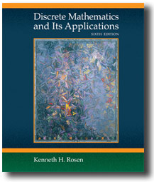

Chapter 3
The Fundamentals: Algorithms, the Integers, and Matrices
Discrete Mathematics
and Its Applications
Sixth Edition
By Kenneth Rosen
歐亞書局

Slide 2
3.1 Algorithms
3.2 The Growth of Functions
3.3 Complexity of Algorithms
3.4 The Integers and Division
3.5 Primes and Greatest Common
Divisors
3.6 Integers and Algorithms
3.7 Applications of Number Theory
3.8 Matrices
歐亞書局
P. 167

Slide 3
3.1 Algorithms
Definition 1: An algorithm is a finite set of precise instructions for performing a computation or for solving a problem.
  Ex: describe an algorithm for finding the maximum value in a finite sequence of integers.

Slide 4
  Sol:
    Set the temporary maximum equal to the first integer
    Compare the next integer to the temporary maximum. If it’s larger, set the temporary maximum to this integer
    Repeat the previous step if there are more integers
    Stop when there are no integers left. The temporary maximum at this point is the largest integer in the sequence
  Pseudocode
    Intermediate step between English description and an implementation in a programming language

Slide 5
Algorithm 1: Finding the Maximum Element in a Finite Sequence
  procedure max(a₁,a₂, .., a_{n}: integers)
  max:=a₁
  for i:=2 to n
  if max < a_{i} then max:= a_{i}
  {max is the largest element}

Slide 6
Properties
Input
Output
Definiteness
Correctness
Finiteness
Effectiveness
Generality

Slide 7
Searching Algorithm
Locate an element x in a list of distinct elements a₁,a₂, .., a_{n}, or determine that it’s not in the list
Algorithm 2: Linear search (sequential search)
  Procedure linear search(x: integer, a₁,a₂, .., a_{n}: distinct integers)
  i:=1
  while (i<=n and x <> a_{i})
  i:=i+1
  if i<=n then location:=i
  else location:=0

Slide 8
Binary Search
Algorithm 3: Binary search
  procedure binary search(x: integer, a₁,a₂, .., a_{n}: increasing integers)
  i:=1
  j:=n
  while i<=j
  begin
  m:=⎣(i+j)/2⎦
  if (x>am) then i:=m+1
  else j:=m
  end
  if x=ai then location:=i
  else location:=0

Slide 9
Sorting
Bubble sort
Algorithm 4: Bubble sort
  Procedure bubblesort(a₁,a₂, .., a_{n}: real numbers with n>=2)
  for i:=1 to n-1
  for j:=1 to n-i
  if a_{j}>a_{j+1} then interchange a_{j} and a_{j+1}

Slide 10
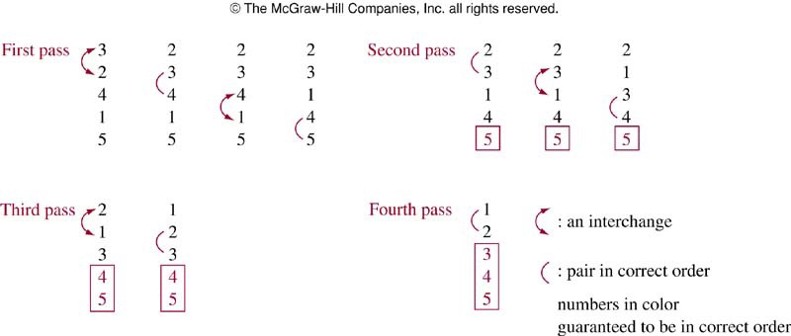
FIGURE 1 (3.1)
FIGURE 1 The Steps of a Bubble Sort.
歐亞書局
P. 173
Notes:
p:\msoffice\My Projects\Rosen 6e 2007\Imagebank\JPEGs07-24-06\ch03\jpeg\03-1-001.jpg

Slide 11
Insertion Sort
Algorithm 5: Insertion Sort
  Procedure insertion sort(a₁,a₂, .., a_{n}: real numbers with n>=2)
  for j:=2 to n
  begin
  i:=1
  while a_{j}>a_{i}
  i:=i+1
  m:=a_{j}
  for k:=0 to j-i-1
  a_{j-k}:=a_{j-k-1}
  a_{i}:=m
  end

Slide 12
Greedy Algorithms
Greedy algorithm: selects the best choice at each step instead of considering all sequence of steps that may lead to an optimal solution
Algorithm 6: Greedy change-making algorithm
  Procedure change(c₁,c₂, .., c_{r}: values of denominations of coins, where c₁>c₂> ...> c_{r}; n: a positive integer)
  for i:=1 to r
  while n>=c_{i}
  begin
  add a coin with value c_{i} to the change
  n:=n-c_{i}
  end

Slide 13
Theorem 1: The greedy algorithm (Algorithm 6) produces change using the fewest coins possible.

Slide 14
The Halting Problem
Is there a procedure that does this:
It takes as input a computer program and input to the program and determines whether the program will eventually stop when run with this input.

Slide 15
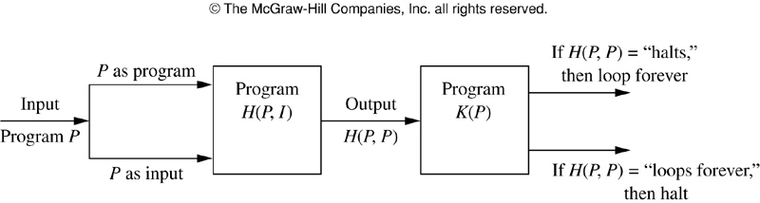
FIGURE 2 (3.1)
FIGURE 2 Showing that the Halting Problem is Unsolvable.
歐亞書局
P. 177
Notes:
p:\msoffice\My Projects\Rosen 6e 2007\Imagebank\JPEGs07-24-06\ch03\jpeg\03-1-002.jpg

Slide 16
3.2 The Growth of Functions
Big-O notation
Definition 1: Let f and g be functions from integers or real numbers to real numbers. We say that f(x) is O(g(x)) if there are constants C and k such that
|f(x)|≤C|g(x)|
whenever x>k.
  “f(x) is big-oh of g(x)”
  witnesses: C, k

Slide 17
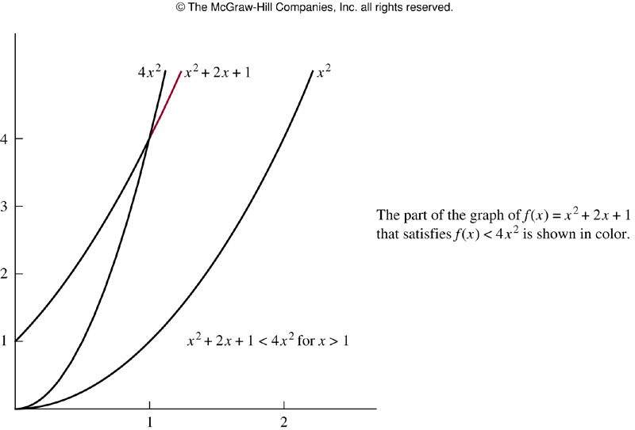
FIGURE 1 (3.2)
FIGURE 1 The Function x² + 2x + 1 is O(x²).
歐亞書局
P. 181
Notes:
p:\msoffice\My Projects\Rosen 6e 2007\Imagebank\JPEGs07-24-06\ch03\jpeg\03-2-001.jpg

Slide 18
f(x) is O(g(x)) and g(x) is O(f(x))
  f(x) and g(x) are of the same order
If f(x) is O(g(x)), and
|h(x)|>|g(x)| for all x>k, then
f(x) is O(h(x))

Slide 19
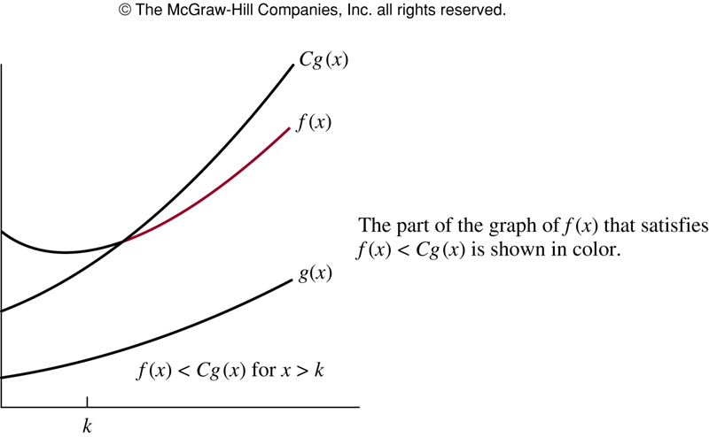
FIGURE 2 (3.2)
FIGURE 2 The Function f(x) is O(g(x)).
歐亞書局
P. 183
Notes:
p:\msoffice\My Projects\Rosen 6e 2007\Imagebank\JPEGs07-24-06\ch03\jpeg\03-2-002.jpg

Slide 20
Theorem 1: Let f(x)= a_{n}x^{n}+ a_{n-1}x^{n-1}+…+ a₁ x+ a₀, where a₀, a₁, …, a_{n-1}, a_{n} are real numbers. Then, f(x) is O(x^{n}).
  Proof
Ex.5: 1+2+…+n
Ex.6: n!

Slide 21
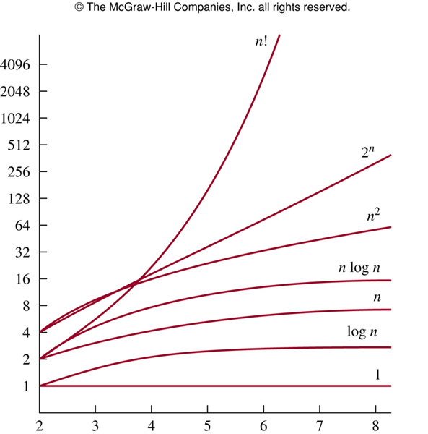
FIGURE 3 (3.2)
FIGURE 3 A Display of the Growth of Functions Commonly Used in Big-O Estimates.
歐亞書局
P. 187
Notes:
p:\msoffice\My Projects\Rosen 6e 2007\Imagebank\JPEGs07-24-06\ch03\jpeg\03-2-003.jpg

Slide 22
Growth of Combinations of Functions
Theorem 2: Suppose that f₁(x) is O(g₁(x)) and f₂(x) is O(g₂(x)). Then (f₁+f₂)(x) is O(max(|g₁(x)|, |g₂(x)|))
  Proof
Corollary 1: Suppose that f₁(x) and f₂(x) are both O(g(x)). Then (f₁+f₂)(x) is O(g(x)).
Theorem 3: Suppose that f₁(x) is O(g₁(x)) and f₂(x) is O(g₂(x)). Then (f₁f₂)(x) is O(g₁(x)g₂(x))
  Proof

Slide 23
Ex.8: f(n)=3nlog(n!)+(n²+3)logn
Ex.9: f(x)=(x+1)log(x²+1)+3x²

Slide 24
Big-Omega and Big-Theta Notation
Definition 2: Let f and g be functions from integers or real numbers to real numbers. We say that f(x) is Ω(g(x)) if there are positive constants C and k such that
|f(x)|≥C|g(x)|
whenever x>k.
  “f(x) is big-Omega of g(x)”

Slide 25
Definition 3: Let f and g be functions from integers or real numbers to real numbers. We say that f(x) is Θ(g(x)) if f(x) is O(g(x)) and f(x) is Ω(g(x)).
  “f(x) is big-Theta of g(x)”
  “f(x) is of order g(x)
  f(X) is Θ(g(x)), then g(x) isΘ(f(x))
Theorem 4: Let f(x)= a_{n}x^{n}+ a_{n-1}x^{n-1}+…+ a₁ x+ a₀, where a₀, a₁, …, a_{n-1}, a_{n} are real numbers with a_{n}≠0. Then, f(x) is of order x^{n}.

Slide 26
3.3 Complexity of Algorithms
Space complexity
  Data structures
Time complexity
  Number of operations required by the algorithm
    Ex. 1 (algorithm 1 in Sec. 3.1)
  Worst-case complexity
    Ex. 2 (linear search)
    Ex. 3 (binary search)
    Ex. 5 (bubble sort)
    Ex. 6 (insertion sort)
  Average-case complexity
    Ex. 4 (linear search)

Slide 27
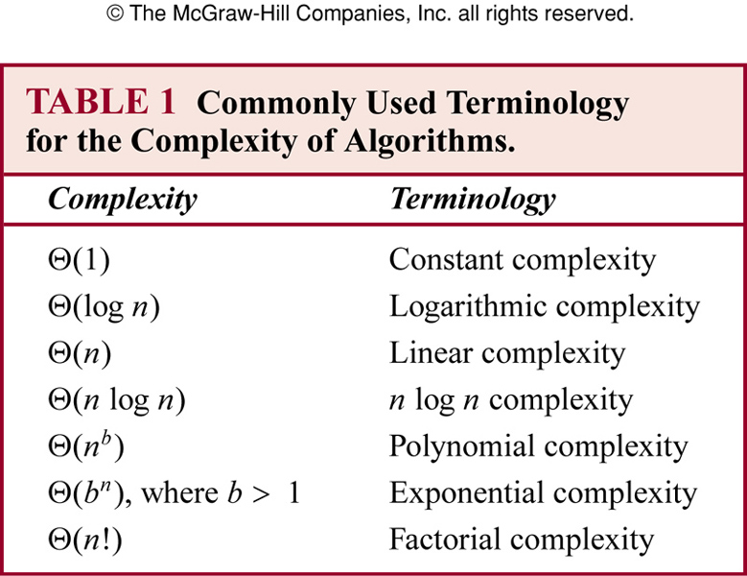
TABLE 1 (3.3)
歐亞書局
P. 196
Notes:
p:\msoffice\My Projects\Rosen 6e 2007\Imagebank\JPEGs07-24-06\ch03\jpeg\t03-3-01.jpg

Slide 28
Understanding the Complexity of Algorithms
Tractable: a problem that is solvable using an algorithm with polynomial worst-case complexity
Intractable
Unsolvable: ex. halting problem
Class P: tractable
Class NP (nondeterministic polynomial time): problems that no algorithm with polynomial worst-case time complexity can solve, but a solution can be checked in polynomial time
NP-complete problems: if any of these problems can be solved by a polynomial worst-case time algorithm, then all problems in the class NP can be solved by a polynomial worst-case time algorithms
  Satisfiability problem
(Chap. 12)
(Wikipedia page on NP and NP-complete)

Slide 29
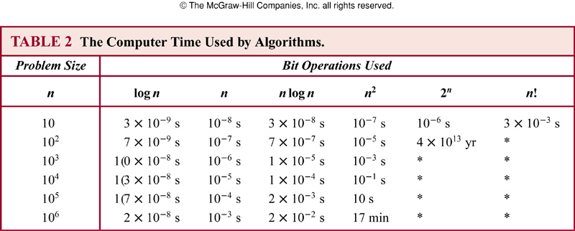
TABLE 2 (3.3)
歐亞書局
P. 198
Notes:
p:\msoffice\My Projects\Rosen 6e 2007\Imagebank\JPEGs07-24-06\ch03\jpeg\t03-3-02.jpg

Slide 30
3.4 The Integers and Division
Definition 1: If a and b are integers with a≠0, we say that a divides b (a|b) if there is an integer c such that b=ac.
  a is a factor of b
  b is a multiple of a

Slide 31
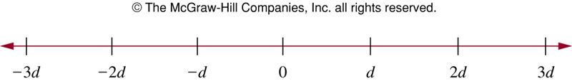
FIGURE 1 (3.4)
FIGURE 1 Integers Divisible by the Positive Integer d.
歐亞書局
P. 201
Notes:
p:\msoffice\My Projects\Rosen 6e 2007\Imagebank\JPEGs07-24-06\ch03\jpeg\03-4-001.jpg

Slide 32
Theorem 1: Let a, b, c be integers. Then
(i) if a|b and a|c, then a|(b+c)
(ii) if a|b, then a|bc for all integers c
(iii) if a|b and b|c, then a|c
Corollary 1: If a, b, and c are integers such that a|b and a|c, then a|mb+nc whenever m and n are integers.

Slide 33
The Division Algorithm
Theorem 2: (The Division Algorithm) Let a be an integer and d a positive integer. Then there are unique integers q and r, with 0<=r<d, such that a=dq+r.
Definition 2: d: divisor, a: dividend, q: quotient, r: remainder.
q = a div d, r = a mod d.

Slide 34
Modular Arithmetic
Definition 3: If a and b are integers and m is a positive integer, then a is congruent to b modulo m if m divides a-b.
  a≡b(mod m)
Theorem 3: Let a and b be integers, and let m be a positive integer. Then a≡b(mod m) iff a mod m = b mod m.

Slide 35
Theorem 4: Let m be a positive integer. The integers a and b are congruent modulo m iff there is an integer k such that a=b+km.
Theorem 5: Let m be a positive integer. If a≡b(mod m) and c≡d(mod m), then
a+c≡b+d(mod m) and ac≡bd(mod m).
Corollary 2: (a+b) mod m=((a mod m)+(b mod m)) mod m
and ab mod m = ((a mod m)(b mod m)) mod m.

Slide 36
Applications of Congruences
Hashing functions
  h(k) = k mod m
Pseudorandom numbers
  x_{n+1}=(ax_{n}+c) mod m
Cryptology
  Caesar cipher: f(p) = (p+k) mod 26

Slide 37
3.5 Primes and Greatest Common Divisors
Definition 1: A positive integer p greater than 1 is called prime if the only positive factors of p are 1 and p.
  Integer n is composite iff there exists an integer a such that a|n and 1<a<n.
Theorem 1: (Fundamental Theorem of Arithmetic) Every positive integer greater than 1 can be written uniquely as a prime or as the product of two or more primes where the prime factors are written in order of nondecreasing size.

Slide 38
Theorem 2: If n is a composite integer, then n has a prime divisor less than or equal to √n.
Theorem 3: There are infinitely many primes.
  Mersenne primes: 2^{p}-1, where p is a prime
Theorem 4: (Prime Number Theorem) The ratio of the number of primes not exceeding x and x/ln x approaches 1 as x grows without bound.

Slide 39
Conjectures and Open Problems about Primes
Ex.6: f(n)=n²-n+41, for n not exceeding 40
  For every polynomial f(n) with integer coefficients, there is a positive integer y such that f(y) is composite.
Ex.7: Goldbach’s Conjecture (1742): every even integer n, n>2, is the sum of two primes.
Ex.8: there are infinitely many primes of the form n²+1, where n is a positive integer.
Ex.9: Twin Prime Conjecture: There are infinitely many twin primes. (Twin primes are primes that differ by 2. )

Slide 40
Greatest Common Divisors and Least Common Multiples
Definition 2: Let a and b be integers, not both zero. The largest integer d such that d|a and d|b is called the greatest common divisor of a and b. (or gcd(a, b))
Definition 3: The integers a and b are relatively prime if their gcd is 1.
Definition 4: The integers a₁, …, a_{n-1}, a_{n} are pairwise relatively prime if gcd(ai, aj)=1 whenever 1≤i<j≤n.

Slide 41
Definition 5: The least common multiple of positive integers a and b is the smallest positive integer that is divisible by both a and b. (or lcm(a, b))
Theorem 5: Let a and b be positive integers. Then
ab=gcd(a,b) lcm(a,b)

Slide 42
3.6 Integers and Algorithms
Representation of Integers
  Decimal, binary, octal, hexadecimal
Theorem 1: Let b be a positive integer greater than 1. Then if n is a positive integer, it can be expressed uniquely in the form
n = a_{k}b^{k}+ a_{k-1}b^{k-1}+…+ a₁ b+ a₀,
where k is a nonnegative integer, a₀, a₁, …, a_{k} are nonnegative integers less than b, and a_{k}≠0.
  Base b expansion of n: (a_{k}a_{k-1}…a₁a₀)_{b}
  Binary expansion, hexadecimal expansion
  Base conversion

Slide 43
Algorithm 1: Constructing Base b Expansions
  Procedure base b expansion(n: positive integer)
  q:=n
  k:=0
  while q<>0
  begin
  ak:=q mod b
  q:=⎣q/b⎦
  k:=k+1
  end

Slide 44
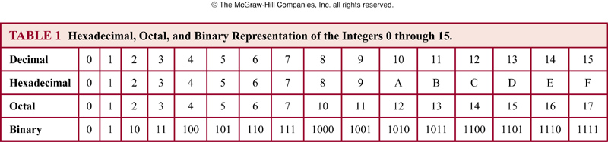
TABLE 1 (3.6)
歐亞書局
P. 222
Notes:
p:\msoffice\My Projects\Rosen 6e 2007\Imagebank\JPEGs07-24-06\ch03\jpeg\t03-6-01.jpg

Slide 45
Algorithms for Integer Operations
a=(a_{n-1}a_{n-2}…a₁a₀)₂, b=(b_{n-1}b_{n-2}…b₁b₀)₂
Algorithm 2: Addition of Integers
  Procedure add(a, b: positive integers)
  c:=0
  for j:=0 to n-1
  begin
  d:=⎣ (aj+bj+c)/2⎦
  sj:=aj+bj+c-2d
  c:=d
  end
  sn:=c
Ex.8:

Slide 46
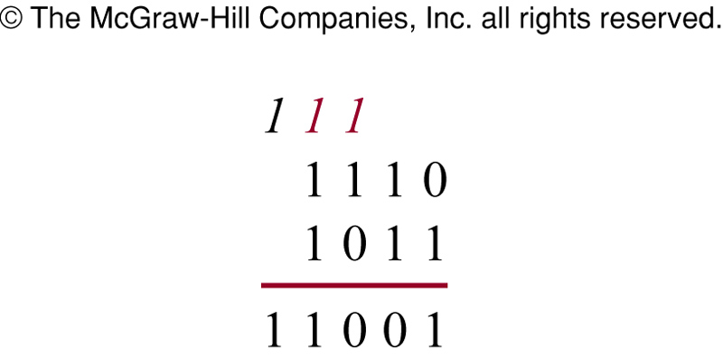
FIGURE 1 (3.6)
FIGURE 1 Adding (1110)₂ and (1011)₂.
歐亞書局
P. 223
Notes:
p:\msoffice\My Projects\Rosen 6e 2007\Imagebank\JPEGs07-24-06\ch03\jpeg\03-6-001.jpg

Slide 47
Algorithm 3: Multiplying Integers
  Procedure multiply(a, b: positive integers)
  for j:=0 to n-1
  begin
  if bj=1 then cj:=a shifted j placed
  else cj:=0
  end
  p:=0
  for j:=0 to n-1
  p:=p+cj
Ex.10:

Slide 48
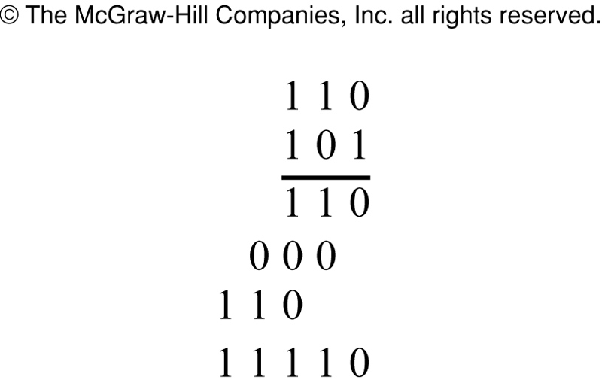
FIGURE 2 (3.6)
FIGURE 2 Multiplying (110)₂ and (101)₂.
歐亞書局
P. 225
Notes:
p:\msoffice\My Projects\Rosen 6e 2007\Imagebank\JPEGs07-24-06\ch03\jpeg\03-6-002.jpg

Slide 49
Algorithm 4: Computing div and mod
  Procedure division algorithm(a: integer, d: positive integer)
  q:=0
  r:=|a|
  while r>=d
  begin
  r:=r-d
  q:=q+1
  end
  if a<0 and r>0 then
  begin
  r:=d-r
  q:=-(q+1)
  end

Slide 50
Modular Exponentiation
b^{n} mod m
n=(a_{k-1}a_{k-2}…a₁a₀)₂
Algorithm 5: Modular Exponentiation
  Procedure modular exponentiation(b: integer, n, m: positive integers)
  x:=1
  power:=b mod m
  for i:=0 to k-1
  begin
  if ai=1 then x:=(x power) mod m
  power:=(power power) mod m
  end

Slide 51
Euclidean Algorithm
Lemma 1: Let a=bq+r, where a, b, q, and r are integers. Then gcd(a,b)=gcd(b,r).
Algorithm 6: Euclidean Algorithm
  Procedure gcd(a, b: positive integers)
  x:=a
  y:=b
  while y<>0
  begin
  r:=x mod y
  x:=y
  y:=r
  end {gcd(a,b) is x}

Slide 52
3.8: Matrices
Definition 1: A matrix is a rectangular array of numbers. A matrix with m rows and n columns is called an m×n matrix.
Definition 2: ith row, jth column, (i,j)th element a_{ij}. A=[a_{ij}].

Slide 53
Matrix Arithmetic
Definition 3: Let A= [a_{ij}] and B=[b_{ij}] be m×n matrices. The sum of A and B, denoted by A+B, is the m×n matrix that has a_{ij}+b_{ij} as its (i,j)th element.
  A+B=[a_{ij}+b_{ij}]
Definition 4: Let A be m×k matrix and B be k×n matrix. The product of A and B, denoted by AB, is the m×n matrix with its (I,j)th element equal to the sum of the products of the corresponding entries from the ith row of A and the jth column of B. If AB = [c_{ij}], then
  c_{ij} =a_{i1}b_{1j}+a_{i2}b_{2j}+…+a_{ik}b_{kj}.

Slide 54
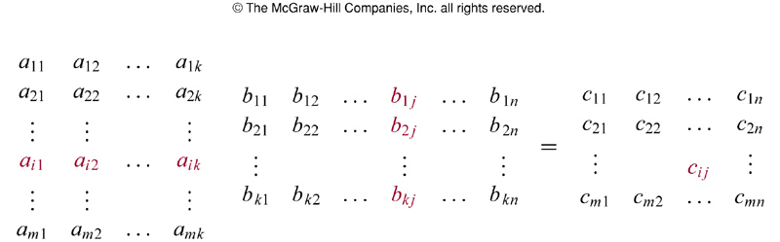
FIGURE 1 (3.8)
FIGURE 1 The Product of A＝[a_{ij}] and B＝[b_{ij}].
歐亞書局
P. 248
Notes:
p:\msoffice\My Projects\Rosen 6e 2007\Imagebank\JPEGs07-24-06\ch03\jpeg\03-8-001.jpg

Slide 55
Algorithms for Matrix Multiplication
Algorithm 1: Matrix Multiplication
  Procedure matrix multiplication(A, B: matrices)
  for i:=1 to m
  for j:=1 to n
  begin
  c_{ij}:=0
  for q:=1 to k
  c_{ij} :=c_{ij}+a_{iq}b_{qj}
  end

Slide 56
Transposes and Powers of Matrices
Definition 5: The identity matrix of order n is the n×n matrix I_{n}=[δ_{ij}], where δ_{ij=1} if i=j and δ_{ij=0} if i≠j.
  AI_{n}= I_{m}A=A
  A⁰= I_{n}, A^{r}=AAA…A
Definition 6: Let A=[a_{ij}]. The transpose of A, denoted by A^{t}, is the n×m matrix obtained by interchanging the rows and columns of A. If A^{t} =[b_{ij}], then b_{ij}= a_{ji} for i=1, 2, …, n and j=1, 2, …, m.
Definition 7: A square matrix A is symmetric if A=A^{t}.

Slide 57
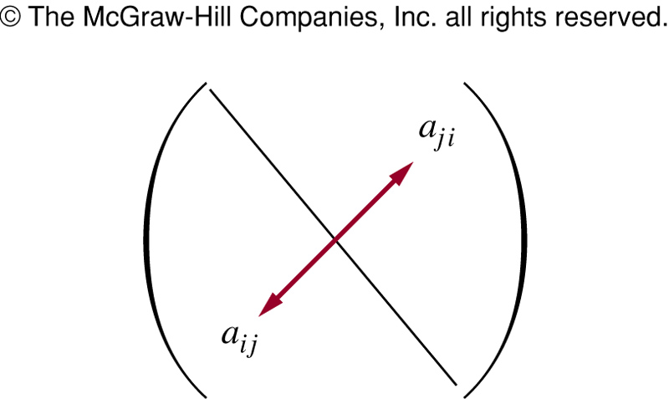
FIGURE 2 (3.8)
FIGURE 2 A Symmetric Matrix.
歐亞書局
P. 252
Notes:
p:\msoffice\My Projects\Rosen 6e 2007\Imagebank\JPEGs07-24-06\ch03\jpeg\03-8-002.jpg

Slide 58
Zero-One Matrices
Zero-one matrix: a matrix with entries that are either 0 or 1
Definition 8: Let A= [a_{ij}] and B=[b_{ij}] be m×n zero-one matrices. The join of A and B is the zero-one matrix with (i,j)th entry a_{ij}∨b_{ij}. The meet of A and B is the zero-one matrix with (i,j)th entry a_{ij}∧b_{ij}.

Slide 59
Definition 9: Let A= [a_{ij}] be m×k zero-one matrix and B=[b_{ij}] be k×n zero-one matrix. The Boolean product of A and B, denoted by A๏B, is the m×n matrix with (i,j)th entry c_{ij} where
c_{ij}=((a_{i1} ∧ b_{1j})∨(a_{i2} ∧ b_{2j})∨ … ∨(a_{ik} ∧ b_{kj}).

Slide 60
Algorithm 2: Boolean product
  Procedure Boolean product(A, B: zero-one matrices)
  for i:=1 to m
  for j:=1 to n
  begin
  c_{ij}:=0
  for q:=1 to k
  c_{ij} :=c_{ij} ∨ (a_{iq} ∧ b_{qj})
  end

Slide 61
Definition 10: Let A be a square zero-one matrix and let r be a positive integer. The rth Boolean power of A is the Boolean product of r factors of A.
  A^{[r]}=A๏A๏…๏A

Slide 62
Thanks for Your Attention!

